Slide 1




NEXT GEN EMPLOYABILITY PROGRAM
Creating a future-ready workforce
Team Members:
College Name
SRM TRP Engineering College
Student Name : PAVITHRAN S
Student ID : au814721104039

Slide 2

CAPSTONE PROJECT SHOWCASE
Project Title
Notes Sharing Web Application using Django Framework
Abstract | Problem Statement | Project Overview | Proposed Solution | Technology Used | Modelling & Results | Conclusion

Slide 3
Abstract
The proposed web platform seeks to simplify document exchange among educators and students within an academic environment. Developed utilizing the Django framework, it will offer an intuitive interface for uploading, downloading, and organizing files. Users can register accounts, participate in designated groups (e.g., classes or departments), and distribute files within these groups. Emphasis will be placed on maintaining robust security measures to safeguard files, permitting access solely to authorized individuals. Ultimately, the objective is to optimize the sharing of documents and foster collaboration within educational circles.
Source :

Slide 4
Problem Statement
In conventional academic settings, exchanging documents between students and instructors can be ineffective and burdensome. Students frequently require submitting assignments or accessing resources, while instructors need to disseminate materials and offer feedback. Nonetheless, current approaches, like email or physical submissions, lack structure and can result in disarray or misplaced documents. To tackle these obstacles, this initiative seeks to create a web-based tool that facilitates smooth document sharing between students and instructors. The tool will offer a centralized hub for uploading, downloading, and organizing documents, fostering collaboration and productivity within academic circles.
Source :

Slide 5
Project Overview
The project entails developing a web application using Django to facilitate document exchange between students and educators. The platform will offer an intuitive interface for uploading, downloading, and managing files, with functionalities tailored to educational settings. Key Features: User Authentication: Students and instructors can establish accounts and sign in to the system. File Upload and Download: Users can upload documents to share with others and retrieve files shared by others. Group Creation and Administration: Users can establish groups (e.g., classes or departments) and distribute documents within these groups. Access Control: Documents are accessible solely to authorized users, ensuring confidentiality and security. Notifications: Users receive alerts for new document uploads, comments, or other pertinent activities. Search Capability: Users can search for documents based on keywords, tags, or other criteria. User Profile: Users can view and manage their profile details, including uploaded files.
Source :

Slide 6
Proposed Solution
The proposed resolution involves creating a web-based application using Django, offering a centralized hub for students and instructors to exchange files. The application will encompass the following key elements: User Administration: Users (students and instructors) can generate accounts, sign in, and oversee their profiles. User verification will ensure only authorized individuals access the system. File Organization: Users can upload files, categorize them into directories, and retrieve files shared by others. The application will support diverse file types, such as documents, images, and videos. Group Supervision: Users can establish or join groups (e.g., classes, departments) and distribute files within these groups. Group managers can oversee group memberships and permissions. Access Management: Files will be accessible solely to sanctioned group members, ensuring confidentiality and privacy. Administrators can configure permissions to regulate file viewing, uploading, or deletion within a group. Notifications: Users will receive alerts for new file uploads, comments, or pertinent activities within their groups, enhancing engagement with the platform. Search Feature: Users can search for files based on keywords, tags, or other criteria, streamlining the process of locating relevant materials. Adaptive Layout: The application will feature an adaptive design, ensuring accessibility and usability across various devices, including computers, laptops, tablets, and smartphones. In summary, the proposed solution aims to offer an intuitive and effective platform for students and instructors to exchange files, fostering collaboration and communication within educational communities.
.

Slide 7


Technology Used
Front-end
Back-end
Source :

Slide 8
Modelling & Results
On this webpage I've developed webpage for both students and teachers, there's a landing page featuring login and signup options, serving as the entry point to the web application. Validation processes, like for "username" and "password," ensure security. Upon logging in, students are directed to a home page where they can view and download files shared by teachers. Conversely, teachers upon login have the ability to upload files. If there's a mismatch in username or password, the webpage indicates no access. In case of errors, a 404 page is displayed, signaling "page not found."
Source :

Slide 9
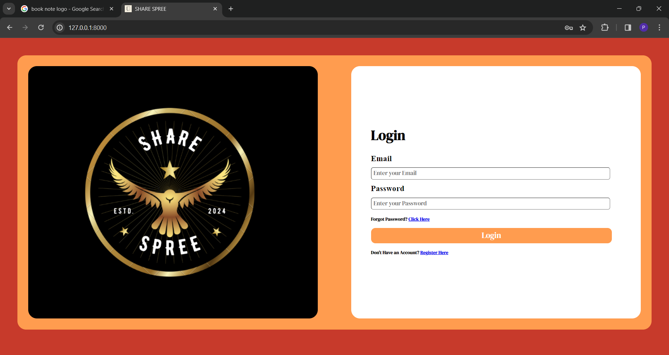
Login page

Slide 10
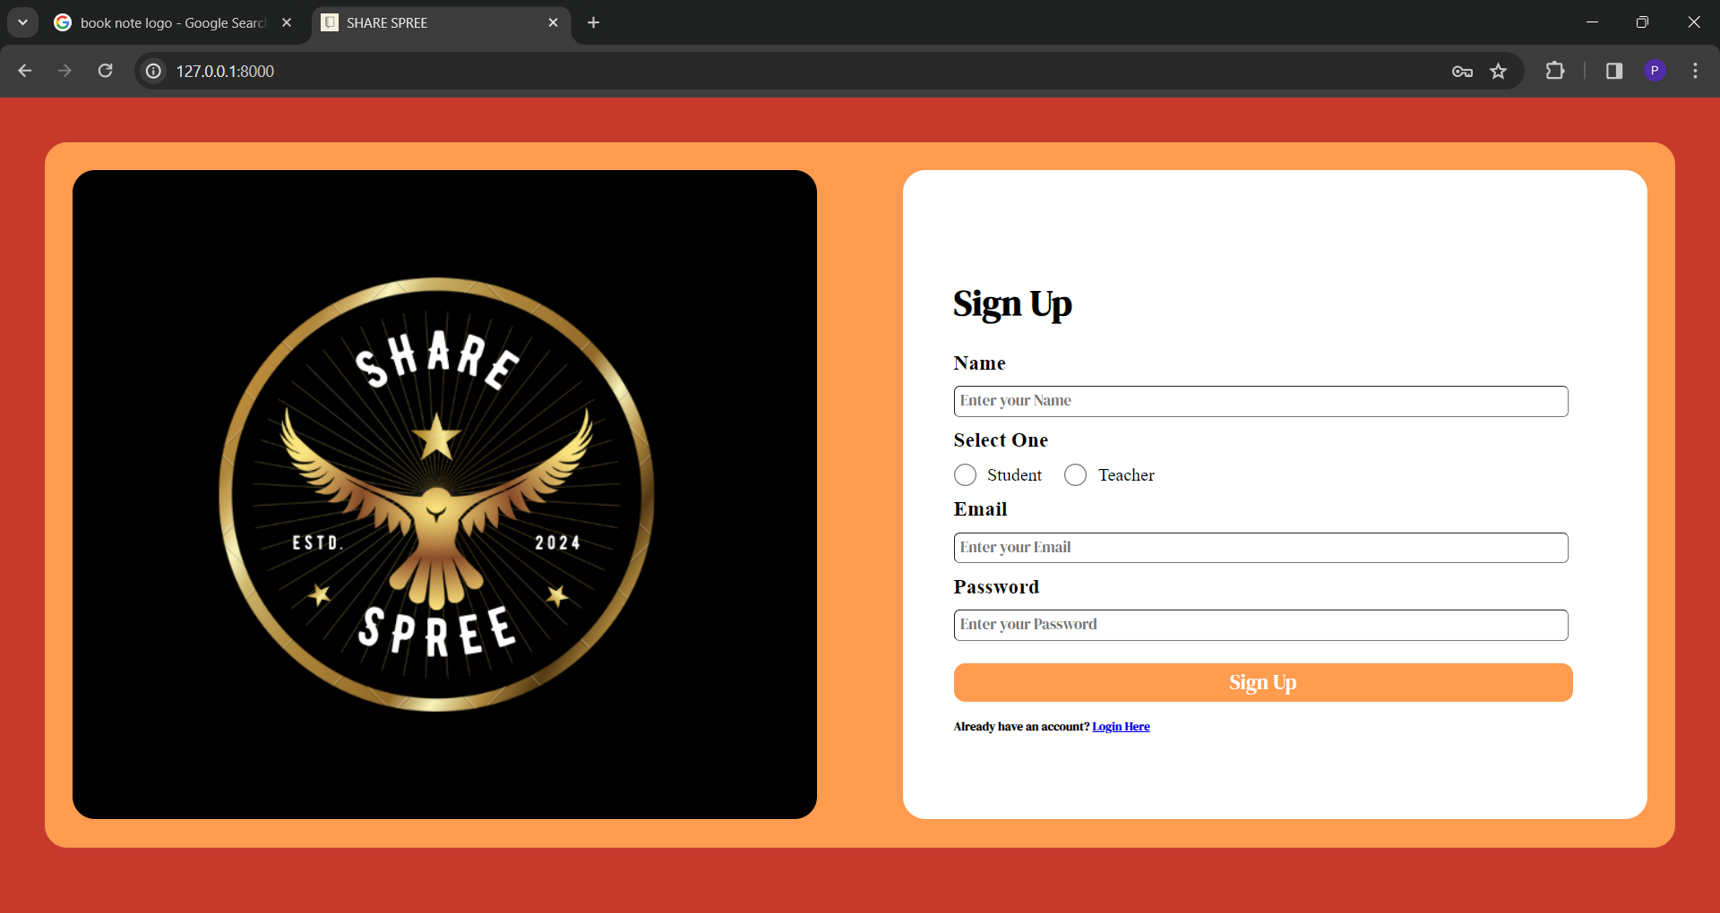
Sign up page

Slide 11
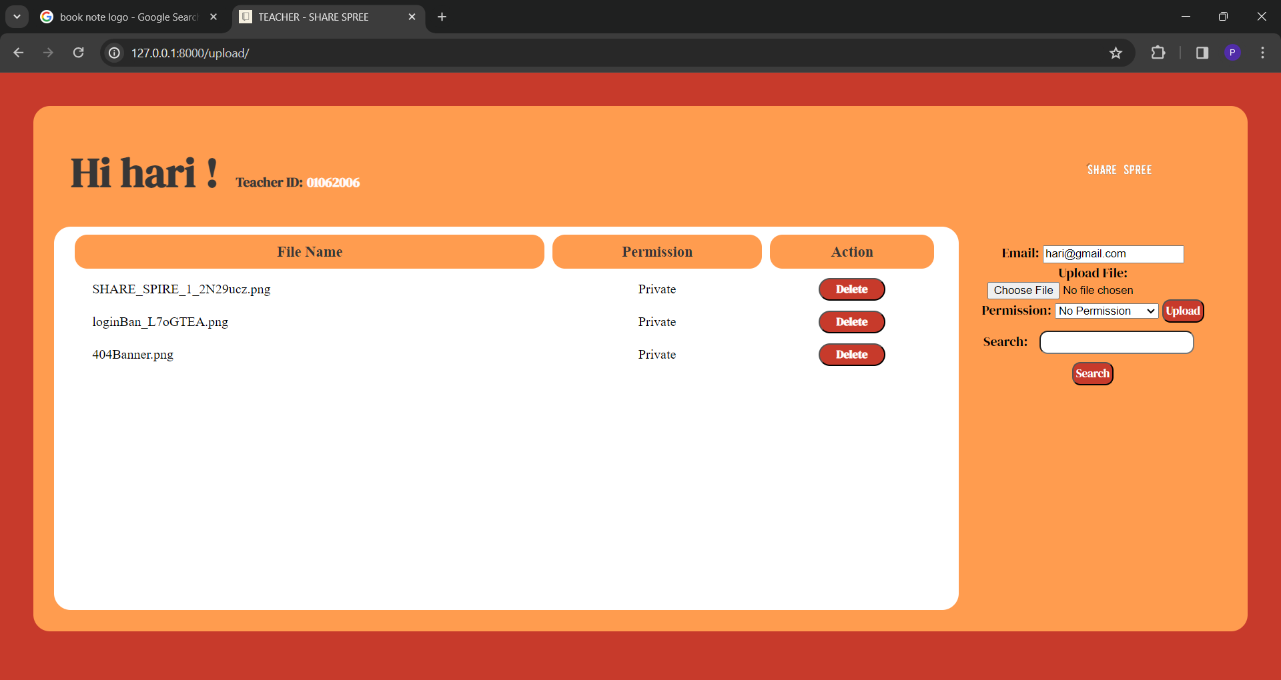
Teachers home page

Slide 12
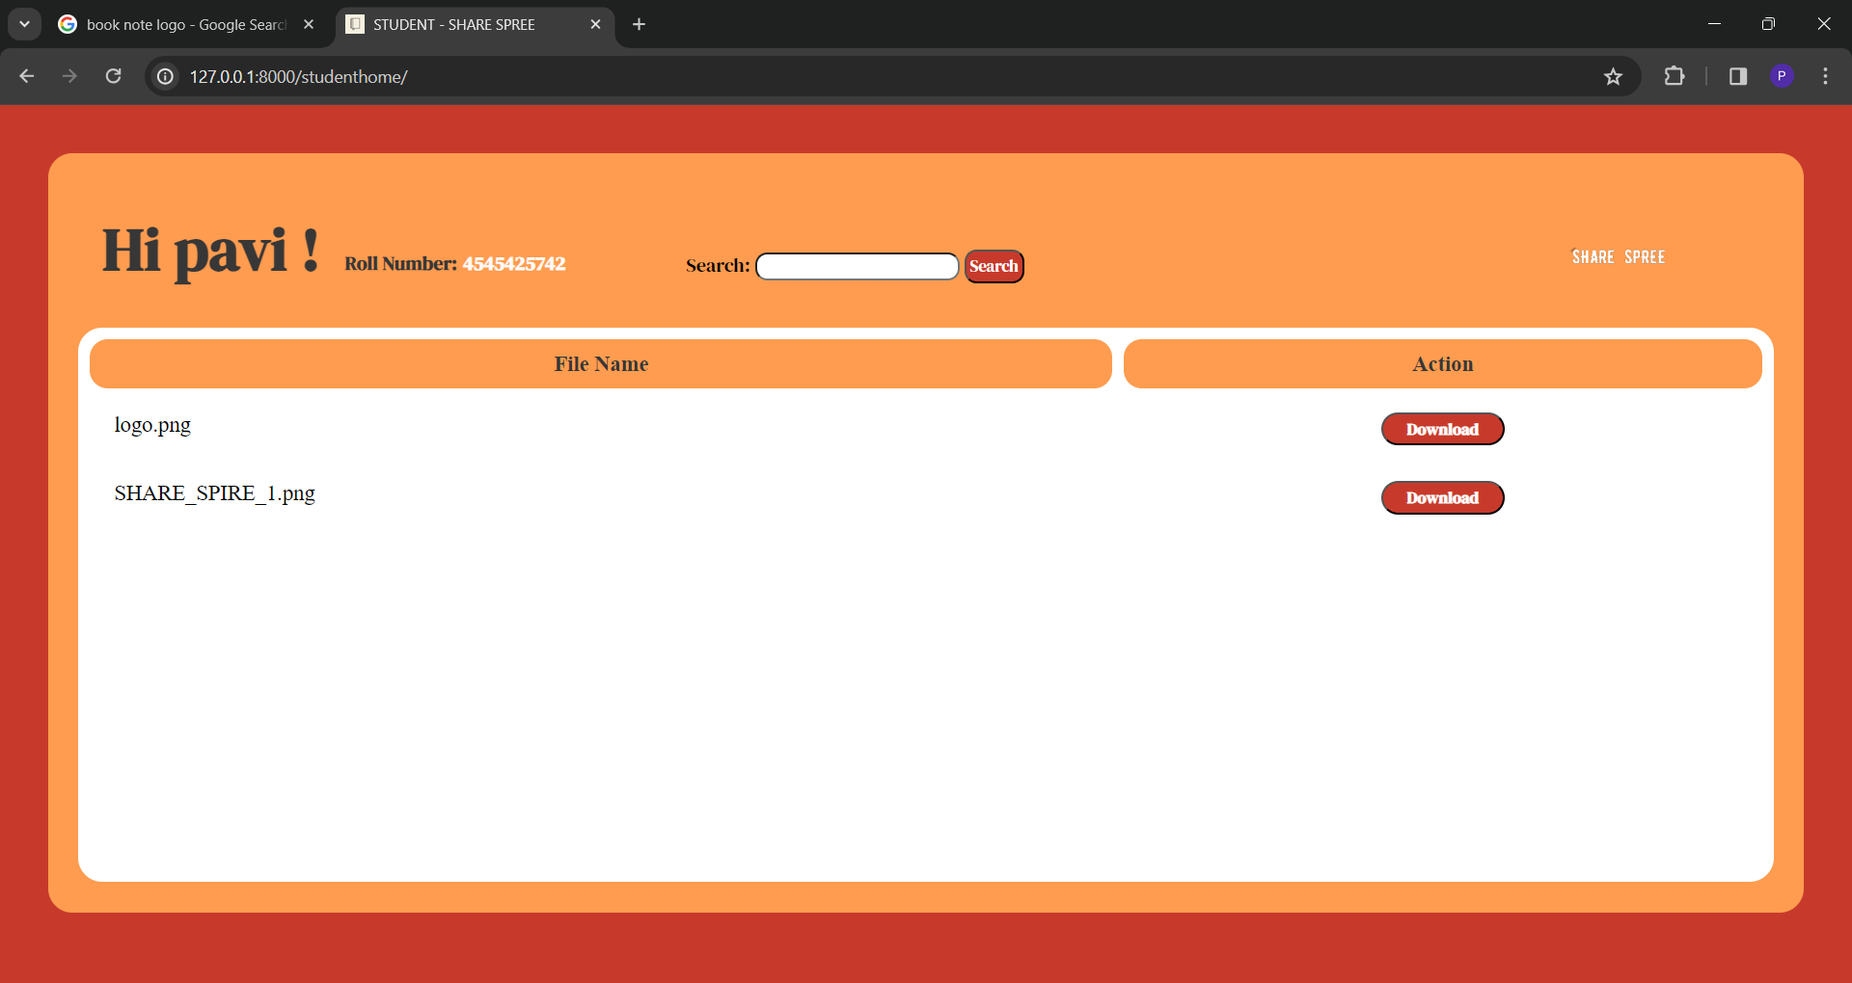
Students home page

Slide 13
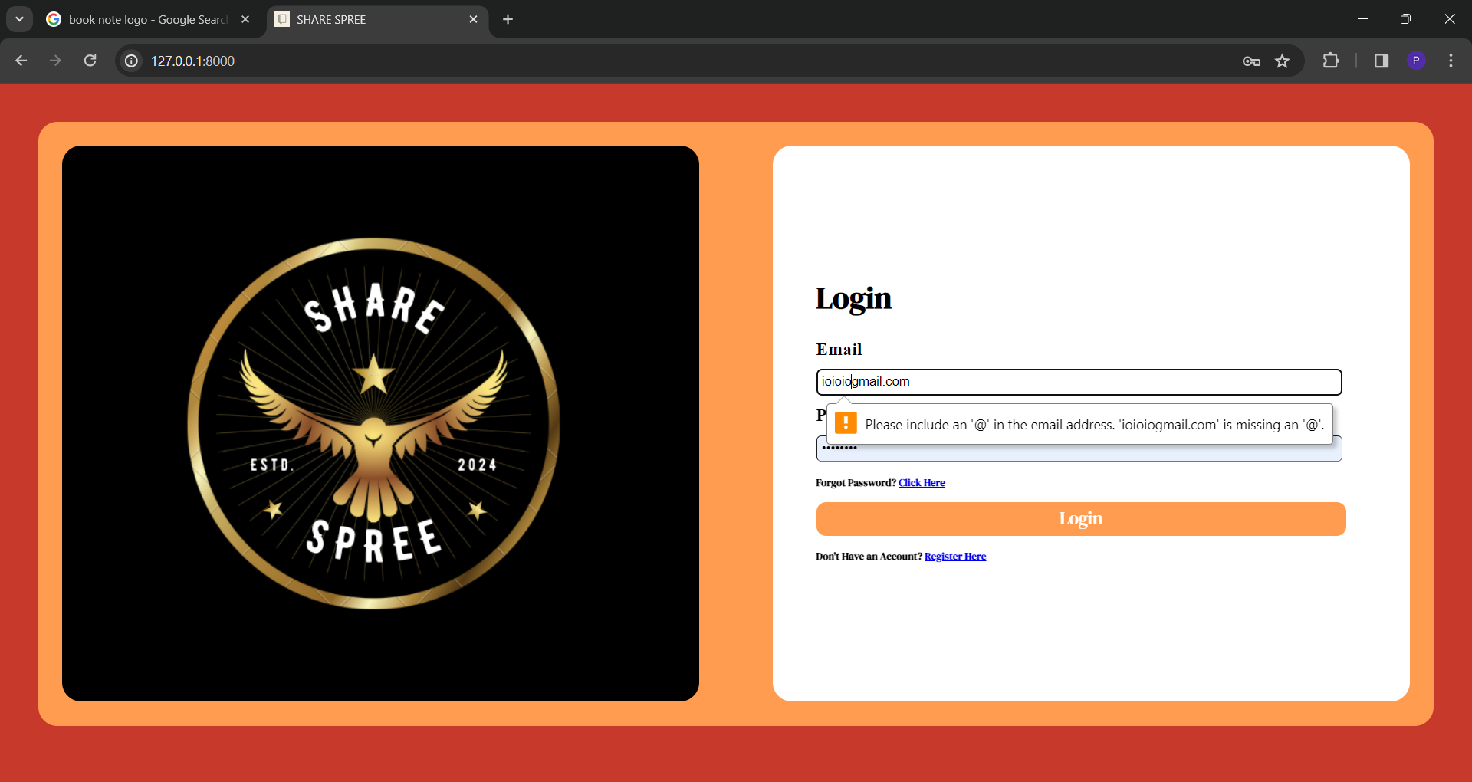
Error notification page

Slide 14
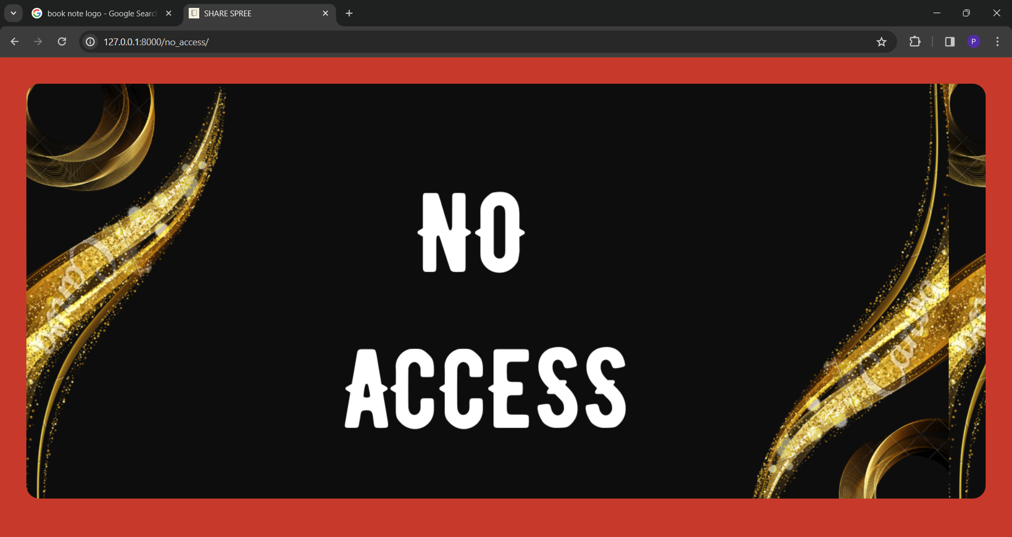
No access

Slide 15
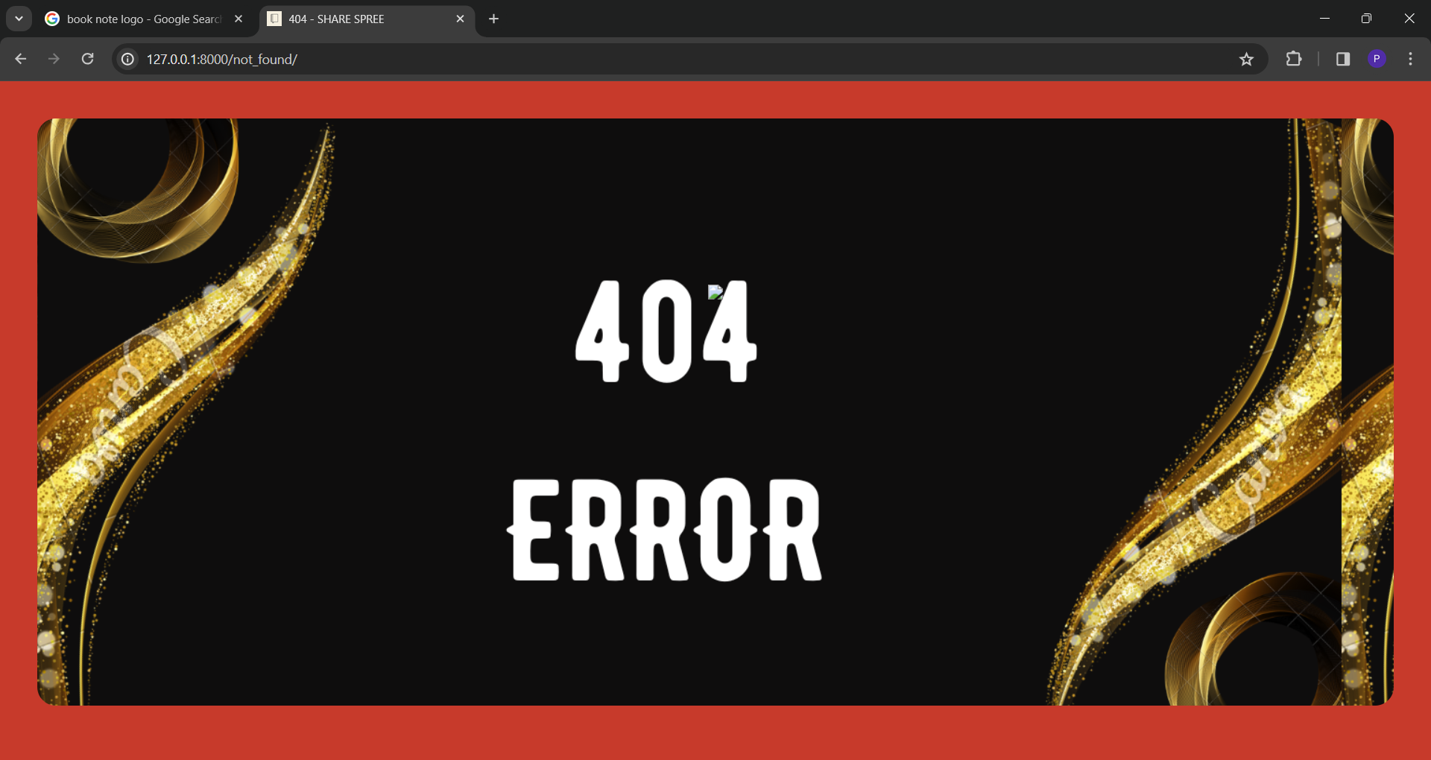
404 ERROR

Slide 16
Future Enhancements:
Integration with Learning Management Systems (LMS): Merge the application with renowned LMS platforms to streamline file exchange within existing educational workflows. File Versioning: Integrate version control for files, enabling users to monitor changes and revert to previous versions as necessary. Integration with Cloud Storage: Enable users to connect their cloud storage accounts (e.g., Google Drive, Dropbox) for seamless file access and sharing. Real-time Collaboration: Introduce functionalities for live collaboration on documents, like simultaneous editing and commenting. Advanced Search: Elevate the search capability with filters, sorting features, and the option to search within file contents. Analytics and Reporting: Offer analytics and reporting functionalities to monitor file usage, user interactions, and engagement metrics. Mobile App: Create a mobile application for iOS and Android devices, allowing users to access and distribute files on the move. Enhanced Security Features: Implement supplementary security measures, such as encryption, to safeguard files and user information. User Feedback System: Incorporate a feedback mechanism to collect input from users and continuously enhance the application based on their input. Integration with Online Learning Tools: Merge with online learning tools (e.g., quizzes, forums) to provide a comprehensive educational platform. These improvements will further enrich the functionality and user-friendliness of the file-sharing application, making it an even more valuable resource for students and educators in educational settings.

Slide 17
Conclusion
The creation of a web-based tool using Django for facilitating file exchange between students and teachers presents a valuable solution to bolster collaboration and productivity within educational contexts. By establishing a centralized hub for file uploading, downloading, and management, the tool simplifies the file-sharing process and enhances overall organization. Key functionalities such as user verification, group supervision, access regulation, notifications, and search capabilities contribute to an intuitive user experience. Future improvements such as real-time cooperation, advanced search options, and integration with educational platforms will further elevate the tool's usefulness and user involvement. In essence, the proposed solution tackles the shortcomings of traditional file-sharing methods in educational settings and furnishes a resilient platform for secure and efficient file exchange among students and teachers.
Source :

Slide 18
Thank You!
Notes:
Thank You !!

